Slide 1

LEARNING EVENT 18th JANUARY
Teams, Process Maps and PDSAs

Slide 2

Nottingham Team

Slide 3
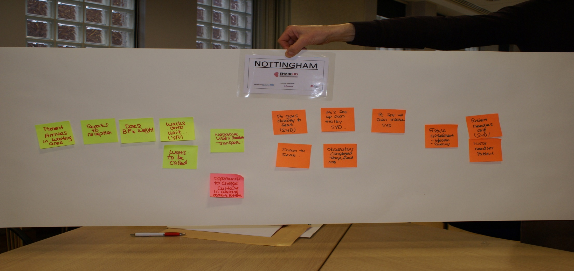
Nottingham process map

Slide 4
Nottingham Process Map
Patient arrives in waiting area
Reports to reception
Does BP and Wt
Walks into unit(SYD)
Negative vibes/transport
Opportunity to change culture
waits to be called
Patient sets up own trolley (SYD)
Patient goes directly to seat (SYD) or Shown to seat
Obs complete, temp, fluids, SOB
Patient sets up own machine(SYD)
Fistula assessment
Infection/swelling
Patient self needles(SYD)
Nurses needle fistula

Slide 5
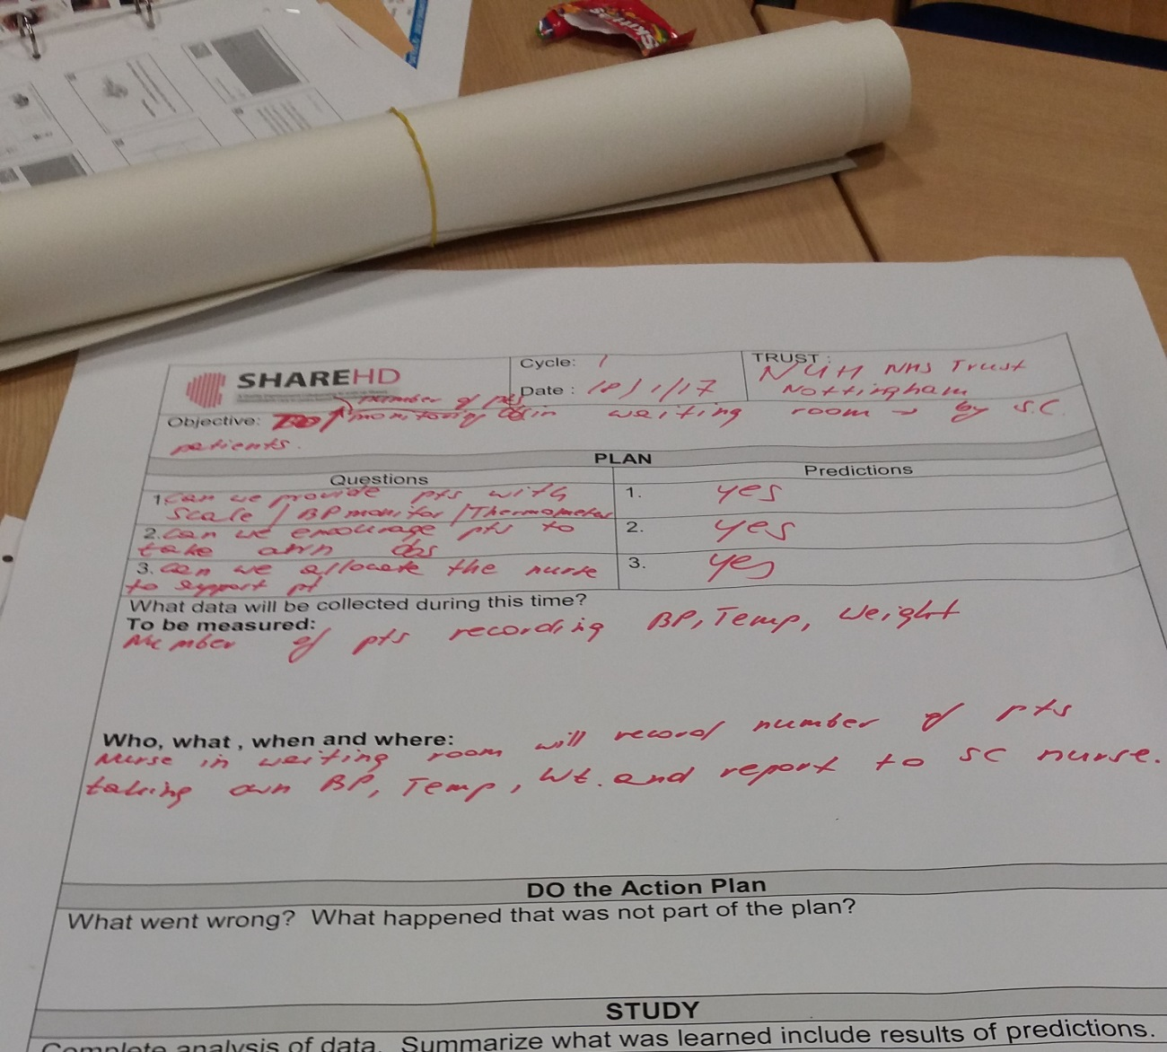
Nottingham

Slide 6

Stevenage Team

Slide 7
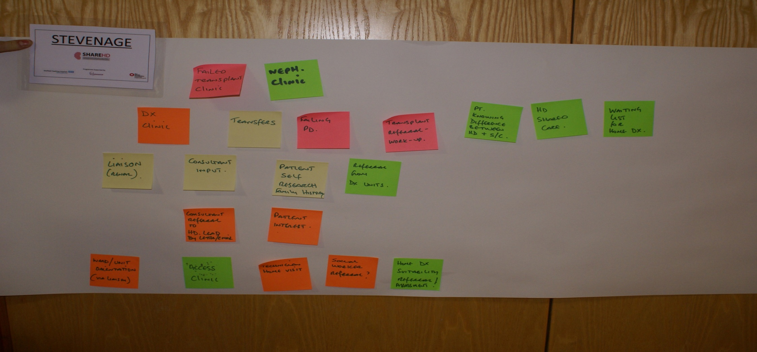
Stevenage Process Map

Slide 8
Stevenage Process Map
Neph Clinic, Failed Transplants, Dialysis Clinic & Transfers from failing PD
Referral from dialysis units
Tx ref / workup
Liason (Renal), Consultant input, Patient self research(family history)
Consultant ref to Lead via letter/email
Patient research
Ward/unit orientation, (no liason), access clinic, technician, home visit, social worker ref
Home dialysis suitability, ref and assesment
Patient knowing difference between HD & S/C, HD shared care and waiting list for HHD

Slide 9
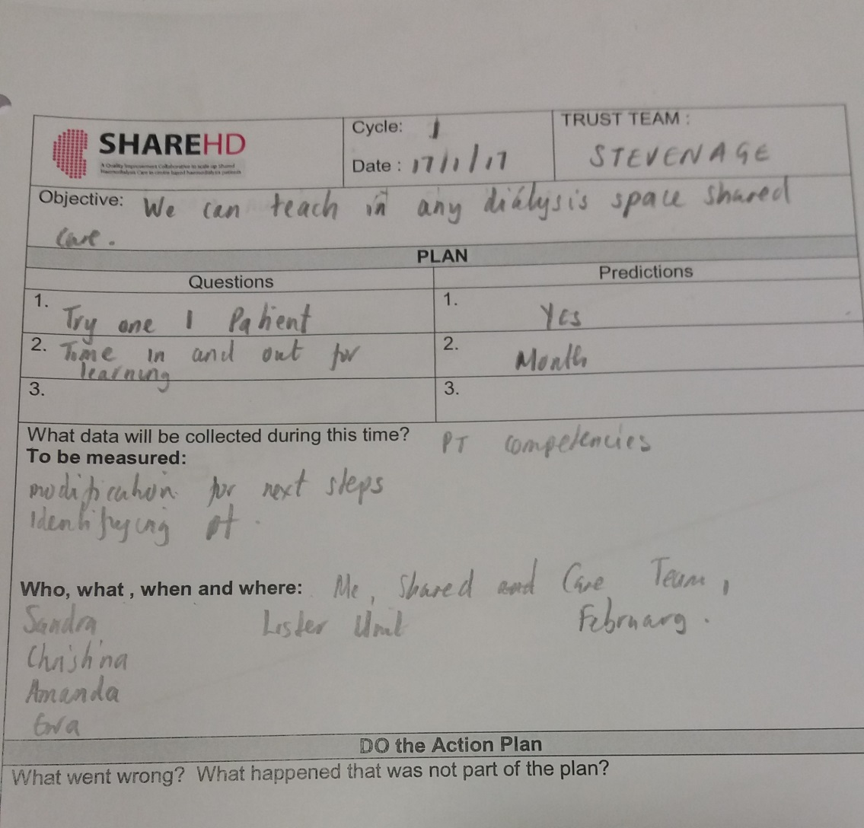
Stevenage

Slide 10

Sheffield team

Slide 11
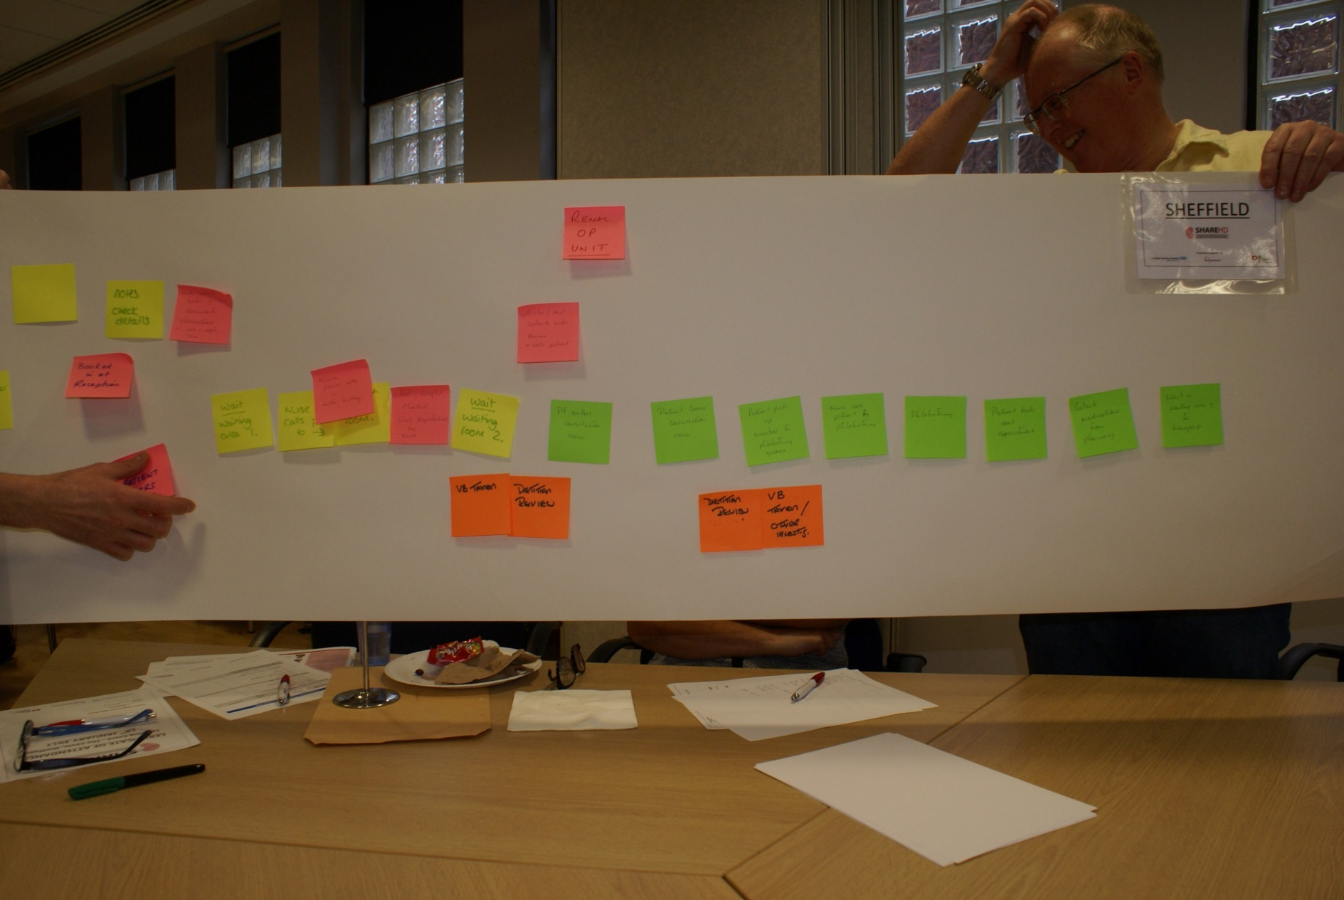
Sheffield Process Map

Slide 12
New Patient enters the unit
Book in at reception
Notes
Check details
Unable to read text
Wait – Waiting area 1
Nurse places notes in notes trolley
Nurse calls patient to xxx
Unable to read text
Wait – Waiting area 2
Doctor/ANP collects notes
Review and calls patients
Patient enters consultation room
Patient leaves consultation room
VB taken
Patient picks up VB number for phlebotomy
Dietician review
Nurse calls patient to phlebotomy
Patient books next appt
phlebotomy
Patient collects meds from pharmacy
Wait in waiting room 1 for transport

Slide 13
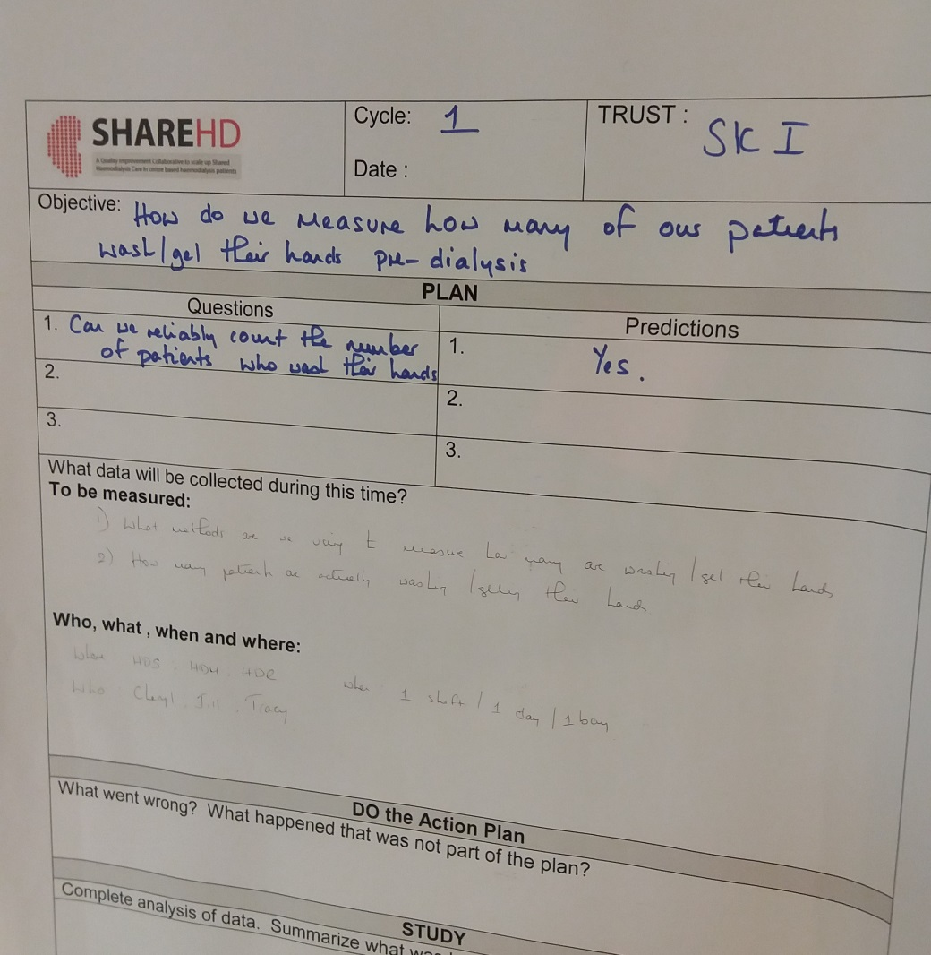
Sheffield

Slide 14
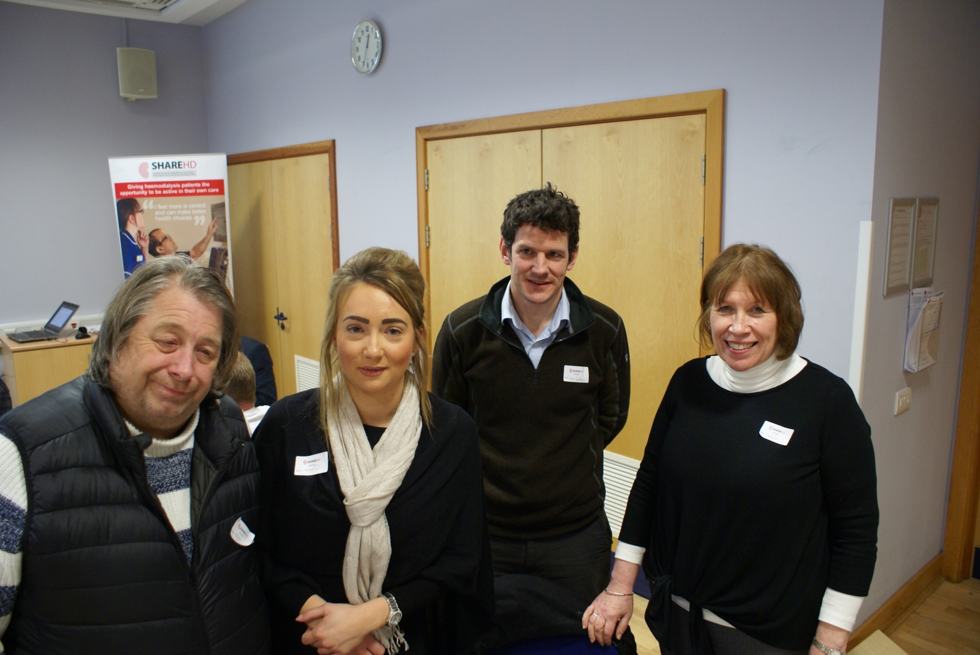
Stoke team

Slide 15
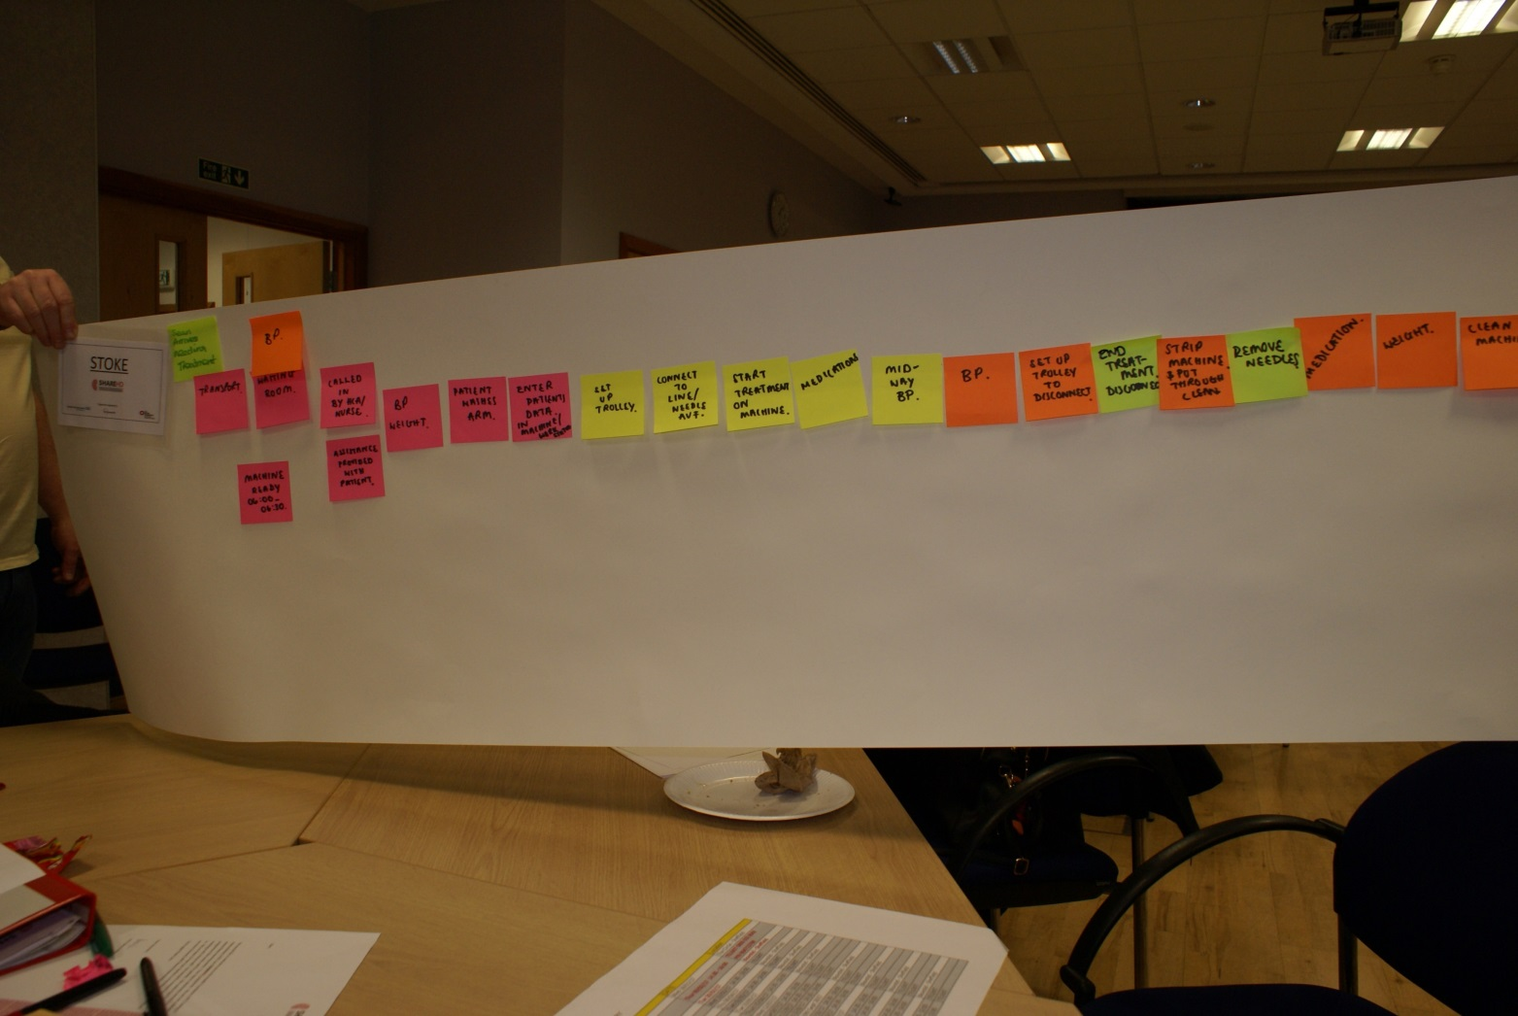
Stoke Process Map

Slide 16
Sean enters requiring treatment
Transport
Waiting room
BP
Machine ready 6.00-6.30 AM
Called in by HCA/nurse
Assistance provided with patient
BP & weight
Patient washes arm
Enters patient data in machine & work xxx
Connect line / needles AVF
Start treatment on machine
Medications
Set up trolley
Midway BP
BP
Setup trolley to disconnect
End treatment, disconnect
Strip machine and put through clean
Remove needles
Medication
Weight

Slide 17
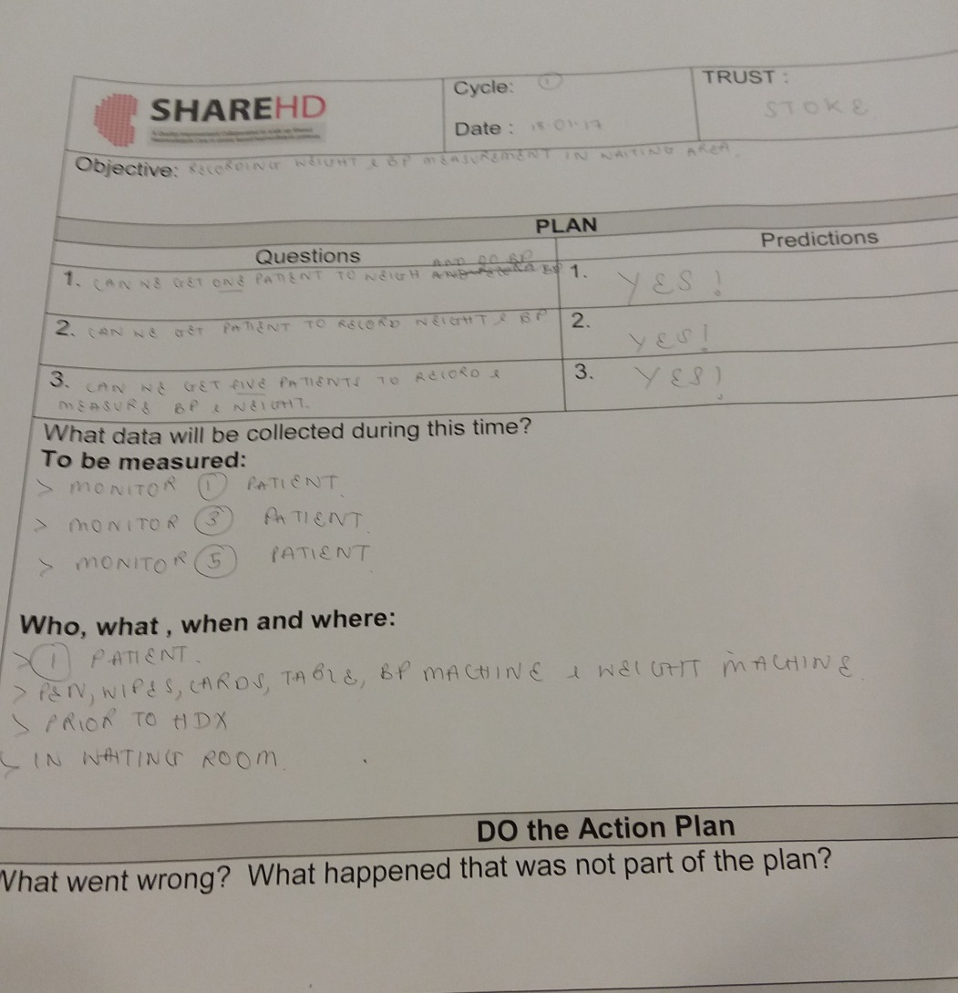
Stoke

Slide 18
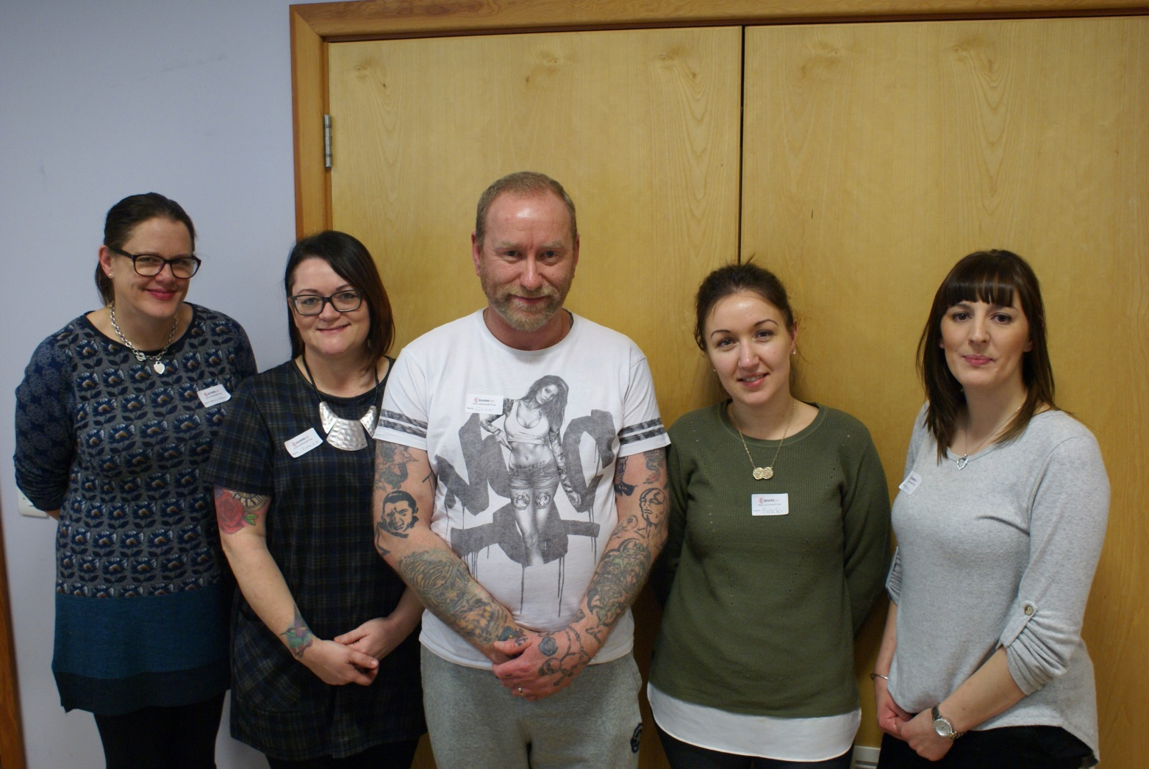
Wolverhampton team

Slide 19
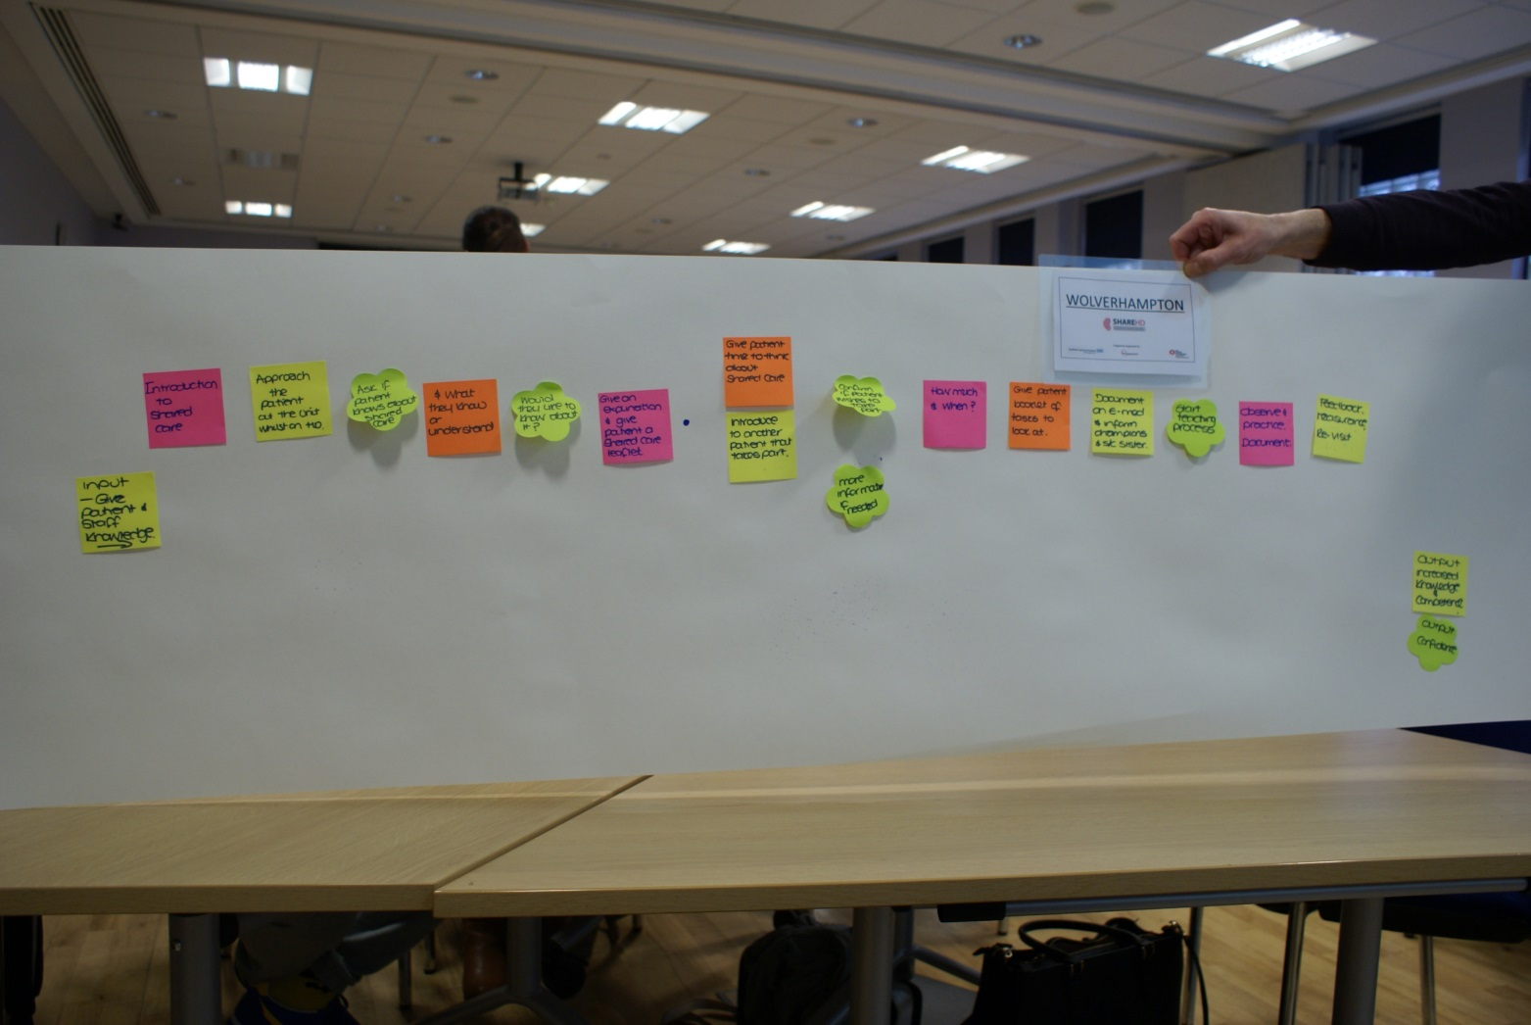
Wolverhampton Process Map

Slide 20
Input – give patient and staff knowledge
Introduction to shared care
Approach patient on HD whilst on treatment
Ask if patient knows about shared care
What they know or understood
Would they like to know about it?
Give an explanation and give patient a shared care leaflet
Give patient time to think about shared care
Introduce patient to another patient that is taking part
Confirm patient wants to take part
Provide more info if required
How much and when
Give patient shared care booklet to look at
Document on Emed & inform champion S/C sister
Start teaching process
Observe, practice & document
Feedback, reassurance & revist

Slide 21
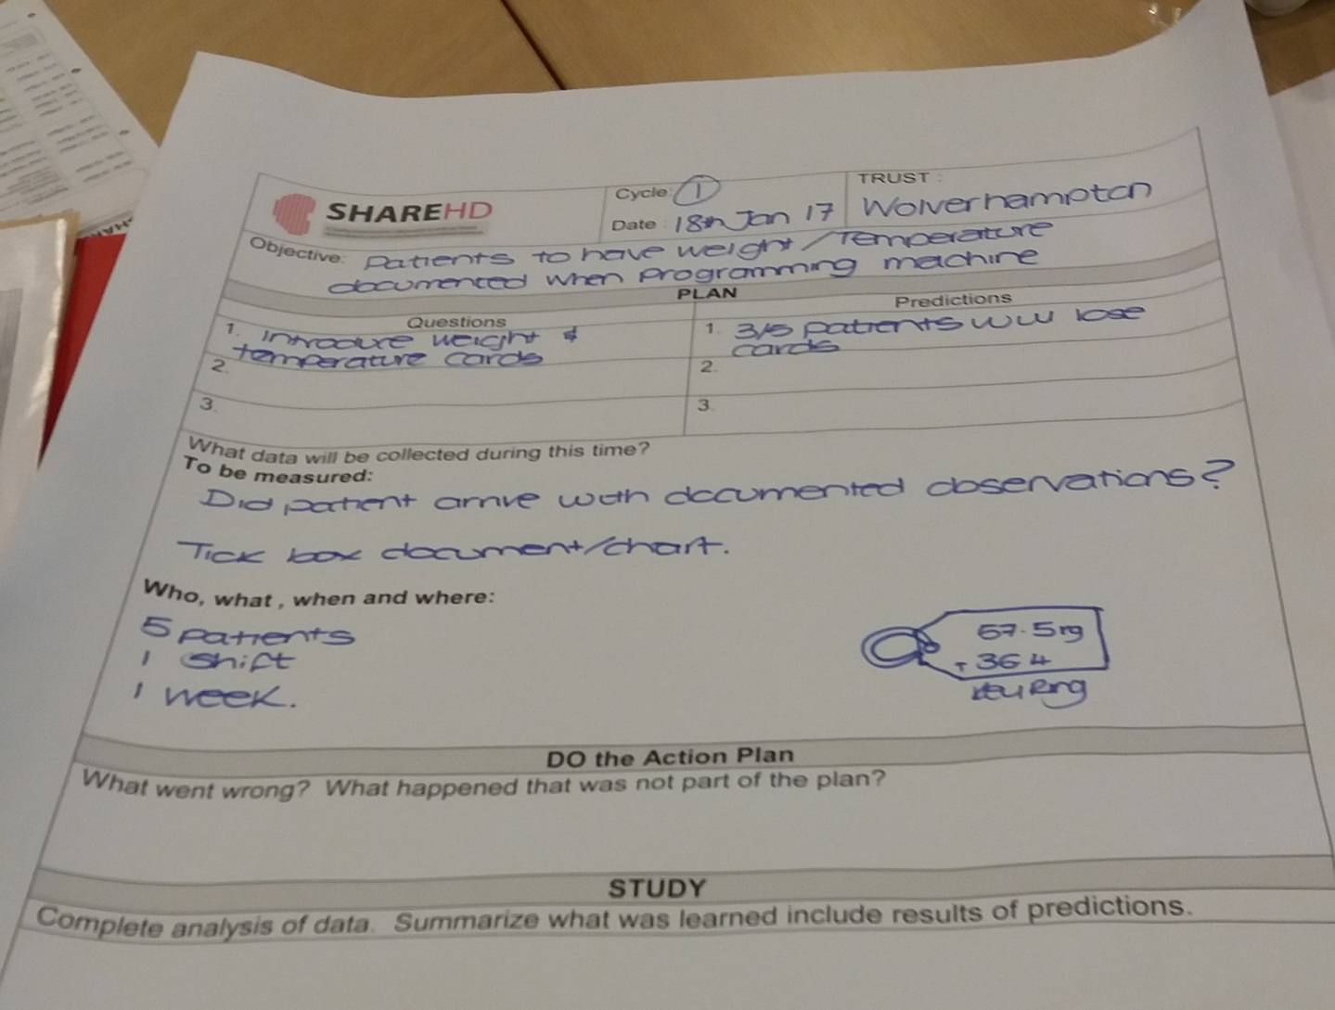
Wolverhampton

Slide 22
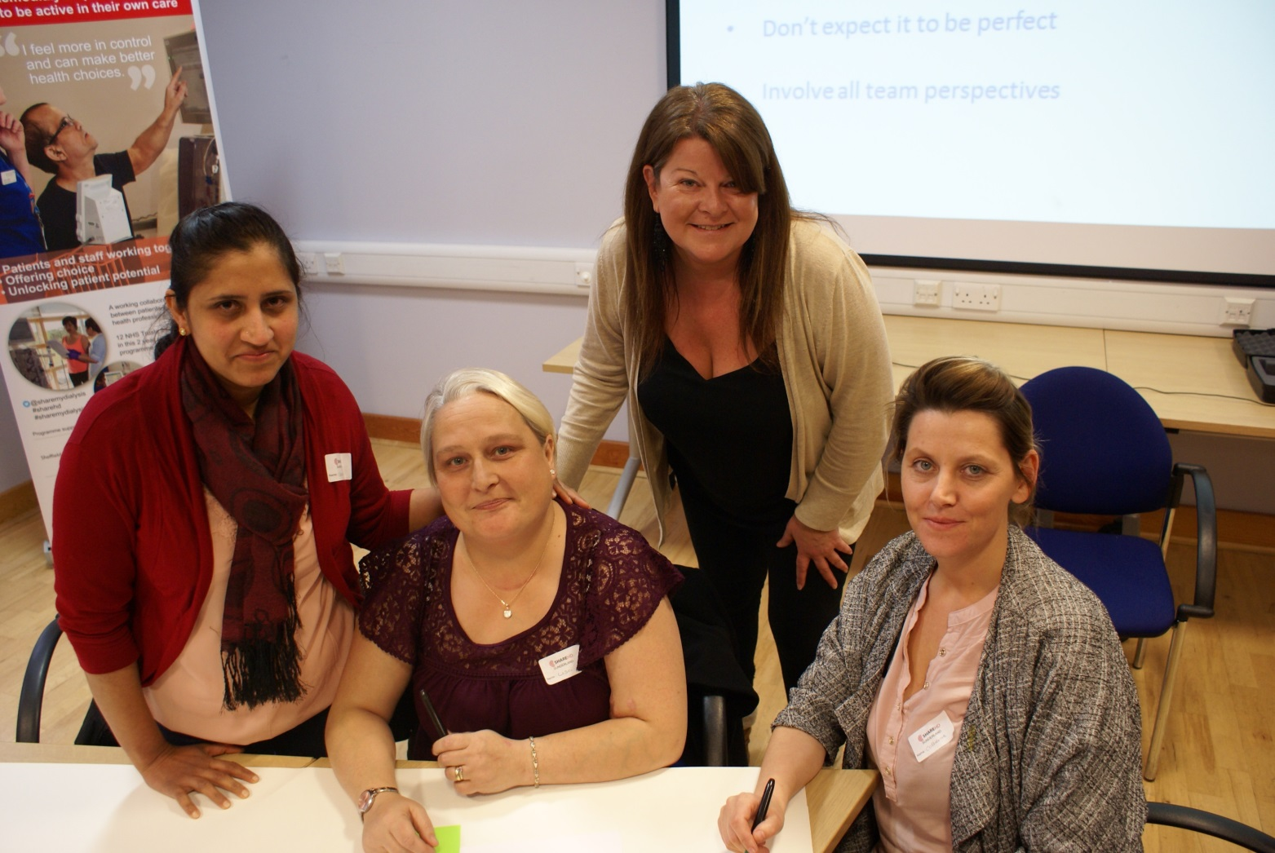
Sunderland team

Slide 23
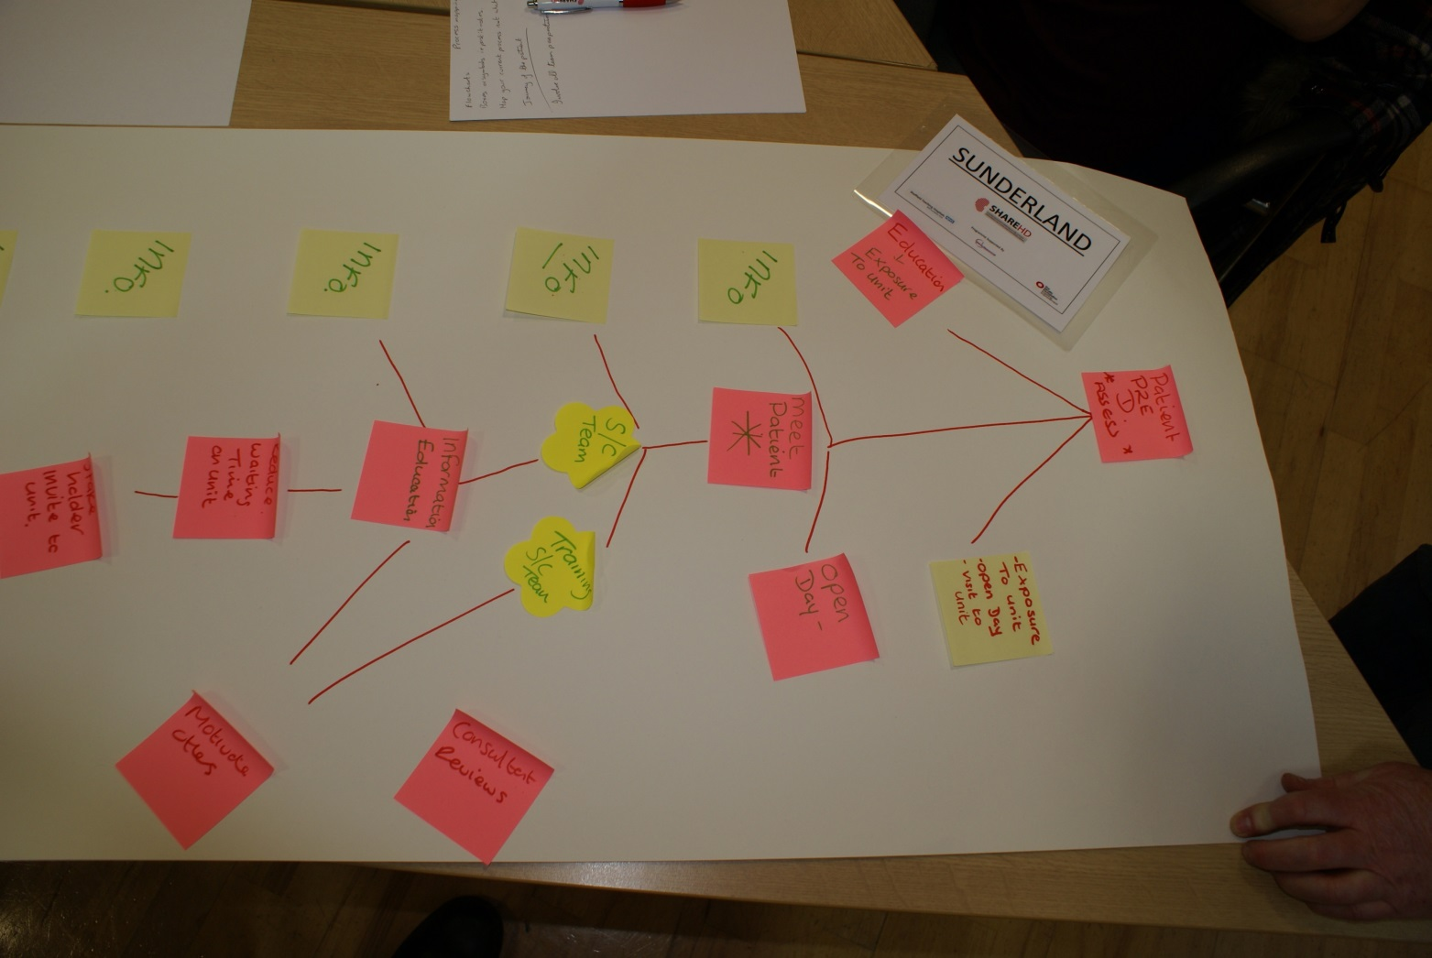
Sunderland Process Map

Slide 24
Invite stakeholder to unit
Information
Consultant reviews
Reduce waiting time in the unit
Information
Motivate others
Information
Education & information
Training SC team
Information
SC team
Open day
Meet Patient
Exposure to unit
Open day
Visit to unit
Education
Exposure to unit
Patient P2E D Assess

Slide 25
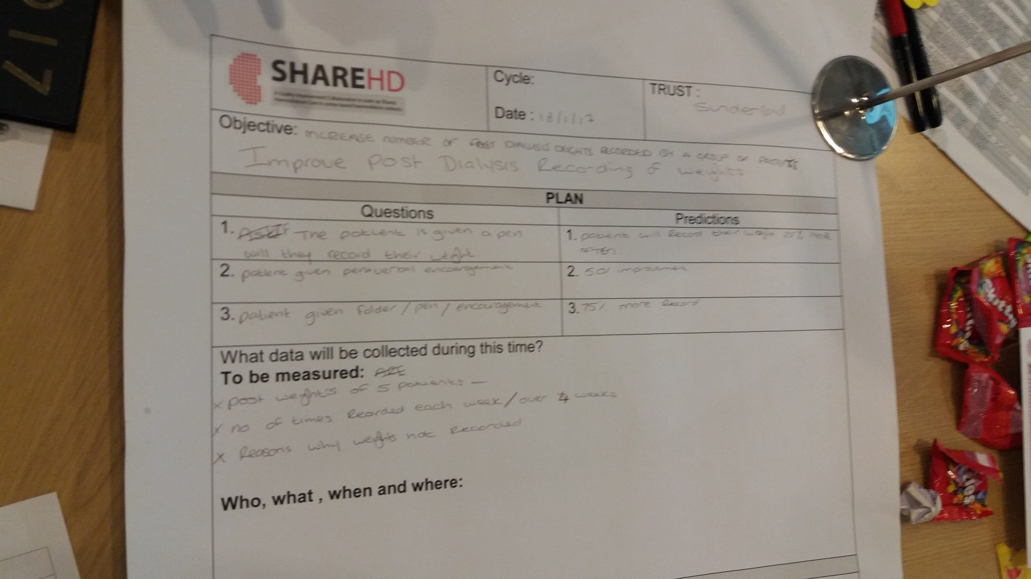
Sunderland

