Slide 1
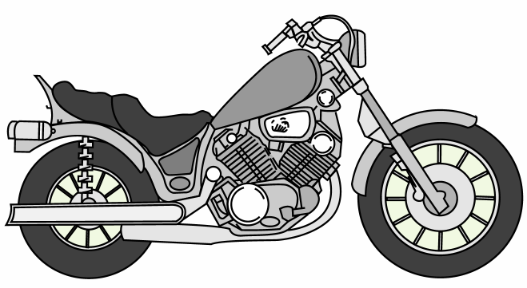
Process Flow Diagram
Frame tube bending
Frame-building work cells
Frame machining
Hot-paint
frame painting
THE ASSEMBLY LINE
TESTING
28 tests
Incoming parts
Engines and transmissions
From Milwaukee on a JIT arrival schedule
Air cleaners
Oil tank work cell
Fluids and mufflers
Shocks and forks
Fuel tank work cell
Handlebars
Wheel work cell
Fender work cell
Roller testing
Crating
Figure 7.3

